Slide 1
Meet The GameDev.tv Community

Slide 2



Meet The Team
Ben Tristem - GameDev.tv CEO
Originally designed the course in 2015.
Gavin "TeslaDev" Milroy - Partner Instructor
Briefly with GameDev.tv in 2019.
Mike Bridges - Senior Founding Instructor
Also known for his Blender courses.

Slide 3
Get The Most From The Course
Do all the challenges when you see them
Visit the Google Slides at gdev.tv/uc2slides
Become an active community member
Become a problem solver
Stay positive & work hard.

Slide 4
You Are NOT Alone
We have a world-class community forum
You can Talk, Show or Ask
Use code formatting in the forum
Include screenshot(s)
For instant help there’s Discord chat server.

Slide 5
Join At Least One Community
Community forum site
Discord live chat server
Unreal Facebook Group
Our Twitch channel
Our YouTube channel
GameDev.tv on Twitter
All links in lecture resources.

Slide 6
How To Ask Good Questions
Paste exact error text into Google first
If you still need help, include error with code
Make the problem reproducible
Short as possible, long as necessary
Answer other people’s questions.

Slide 7
Compilers & VS Community 2019

Slide 8
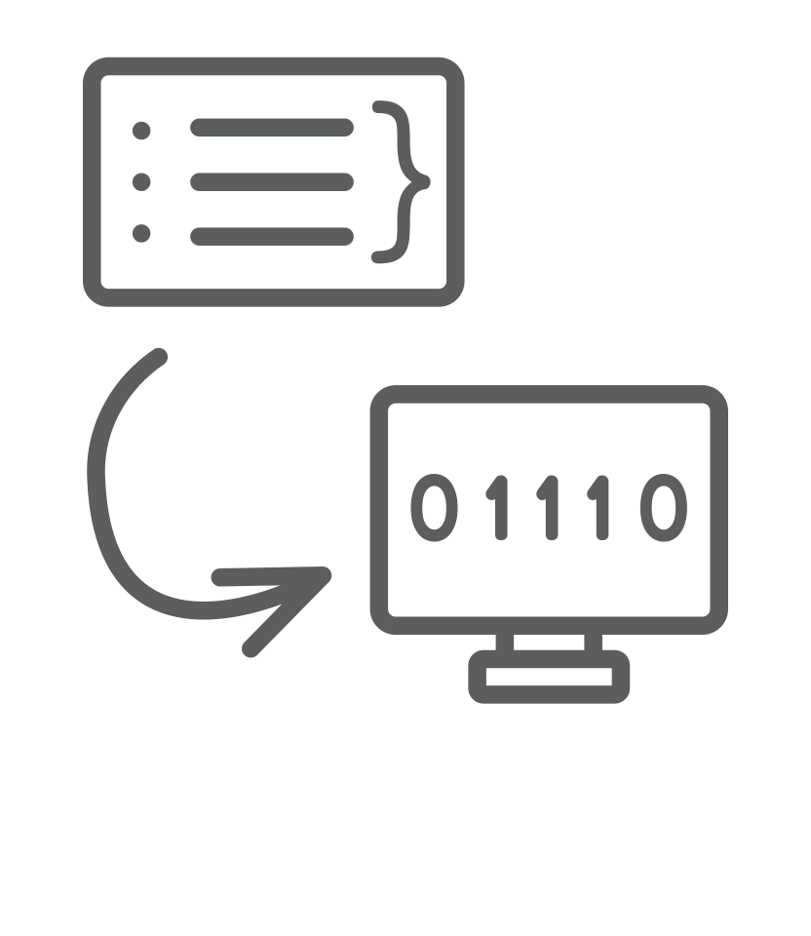
What is a Compiler?
We want to speak "English"
AKA a "high level language"
The computer wants binary
Text gets converted to binary
This is called compilation

Slide 9

Unreal Development Environment

Slide 10
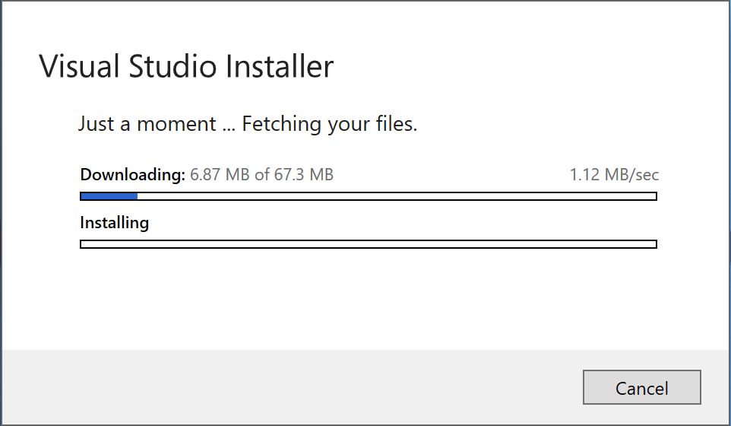

Slide 11
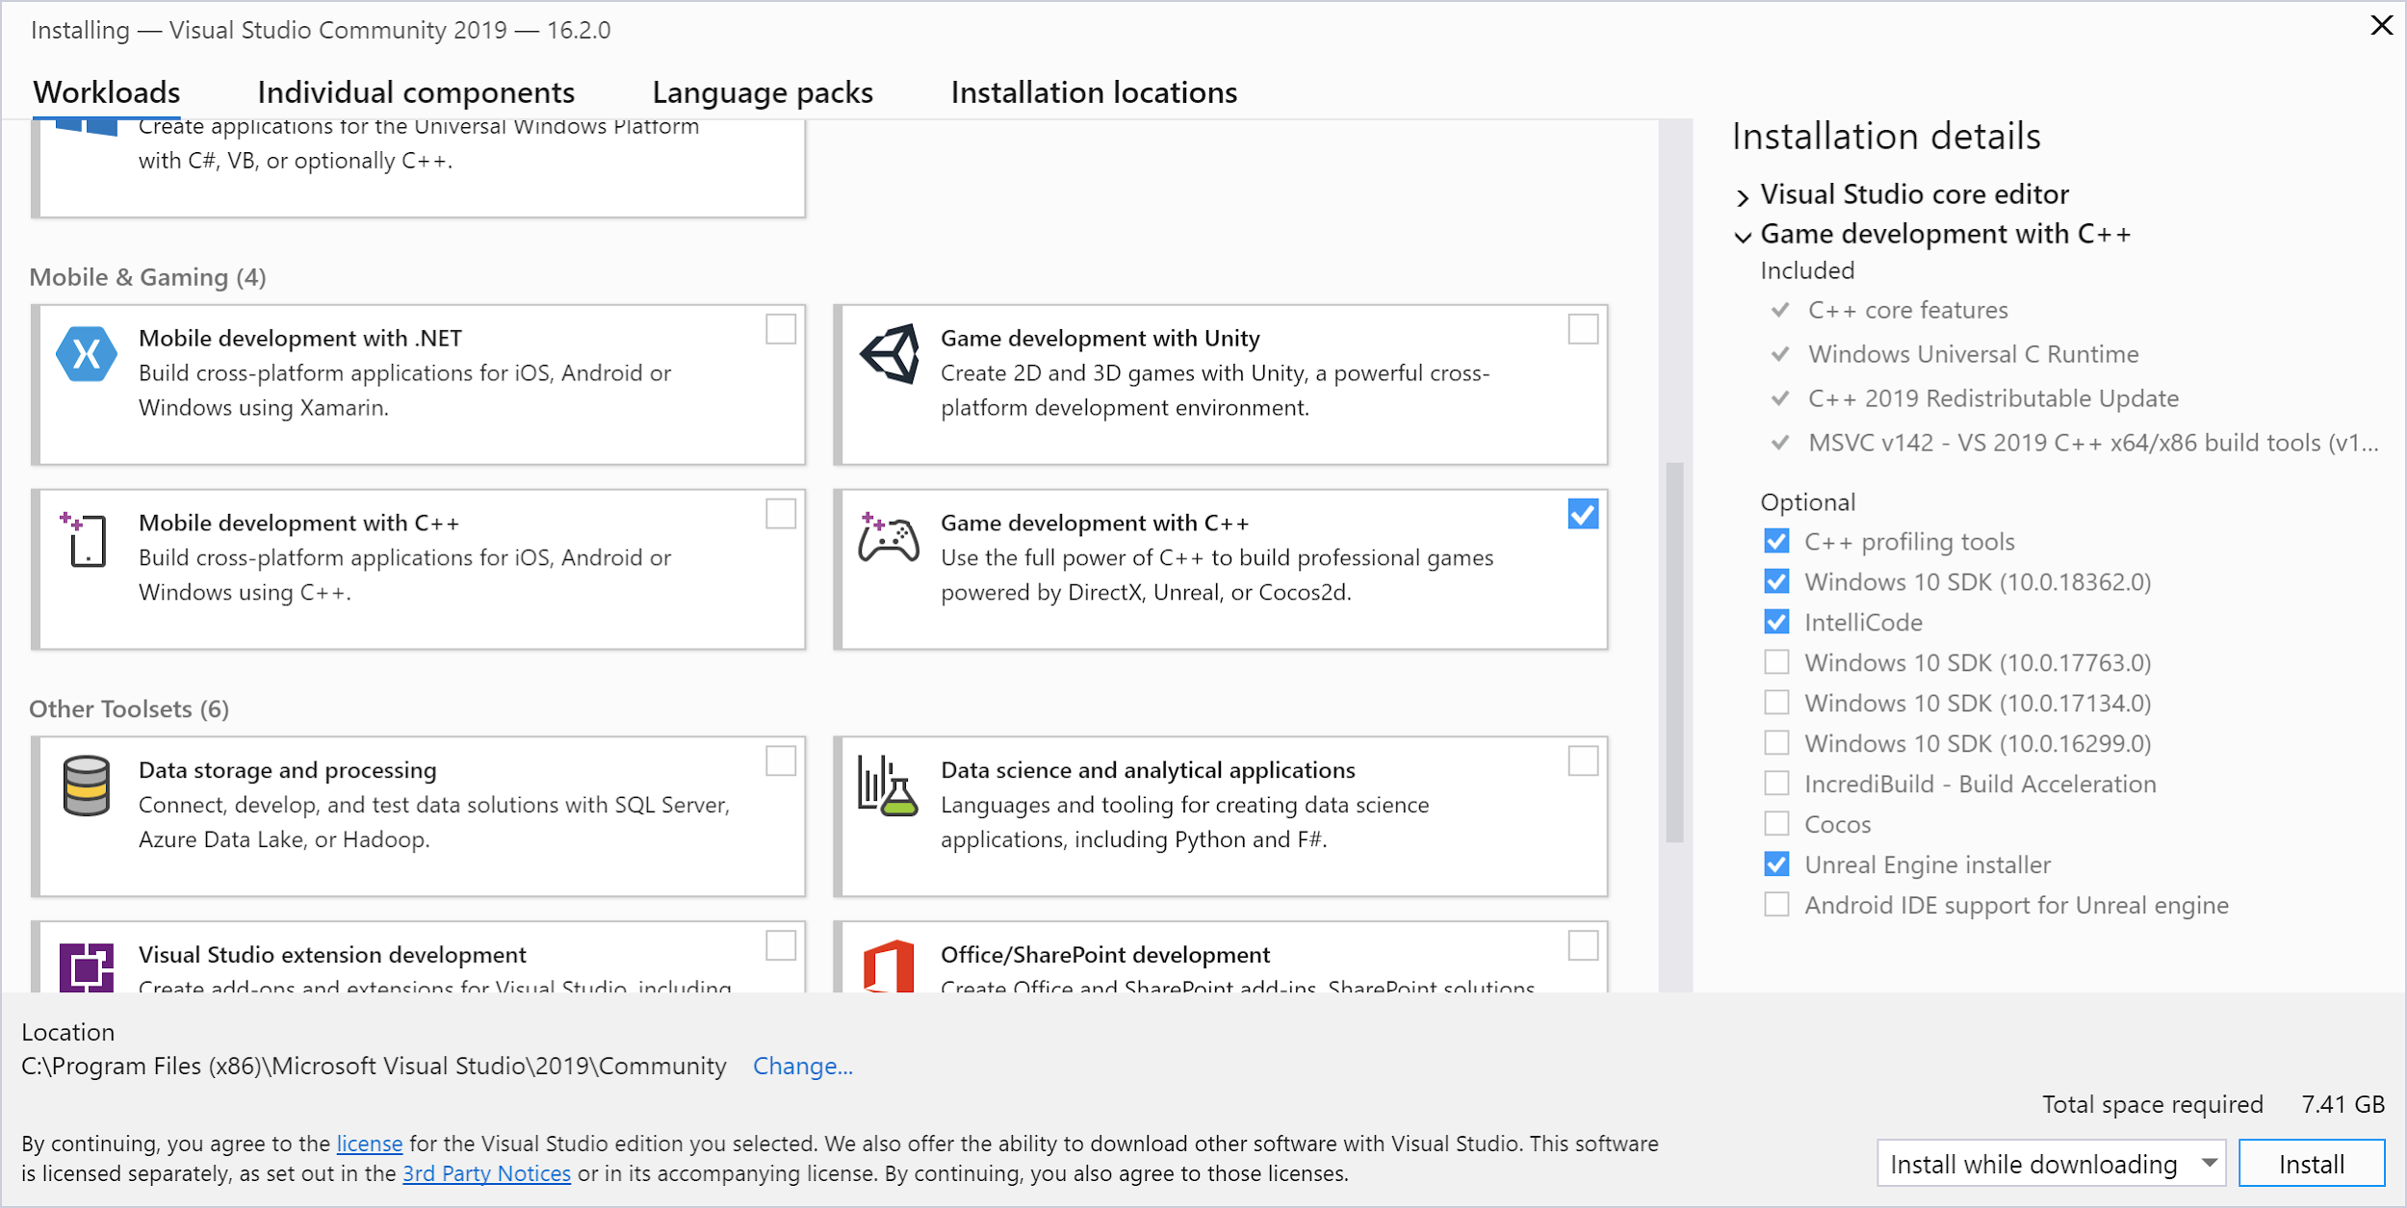

Slide 12
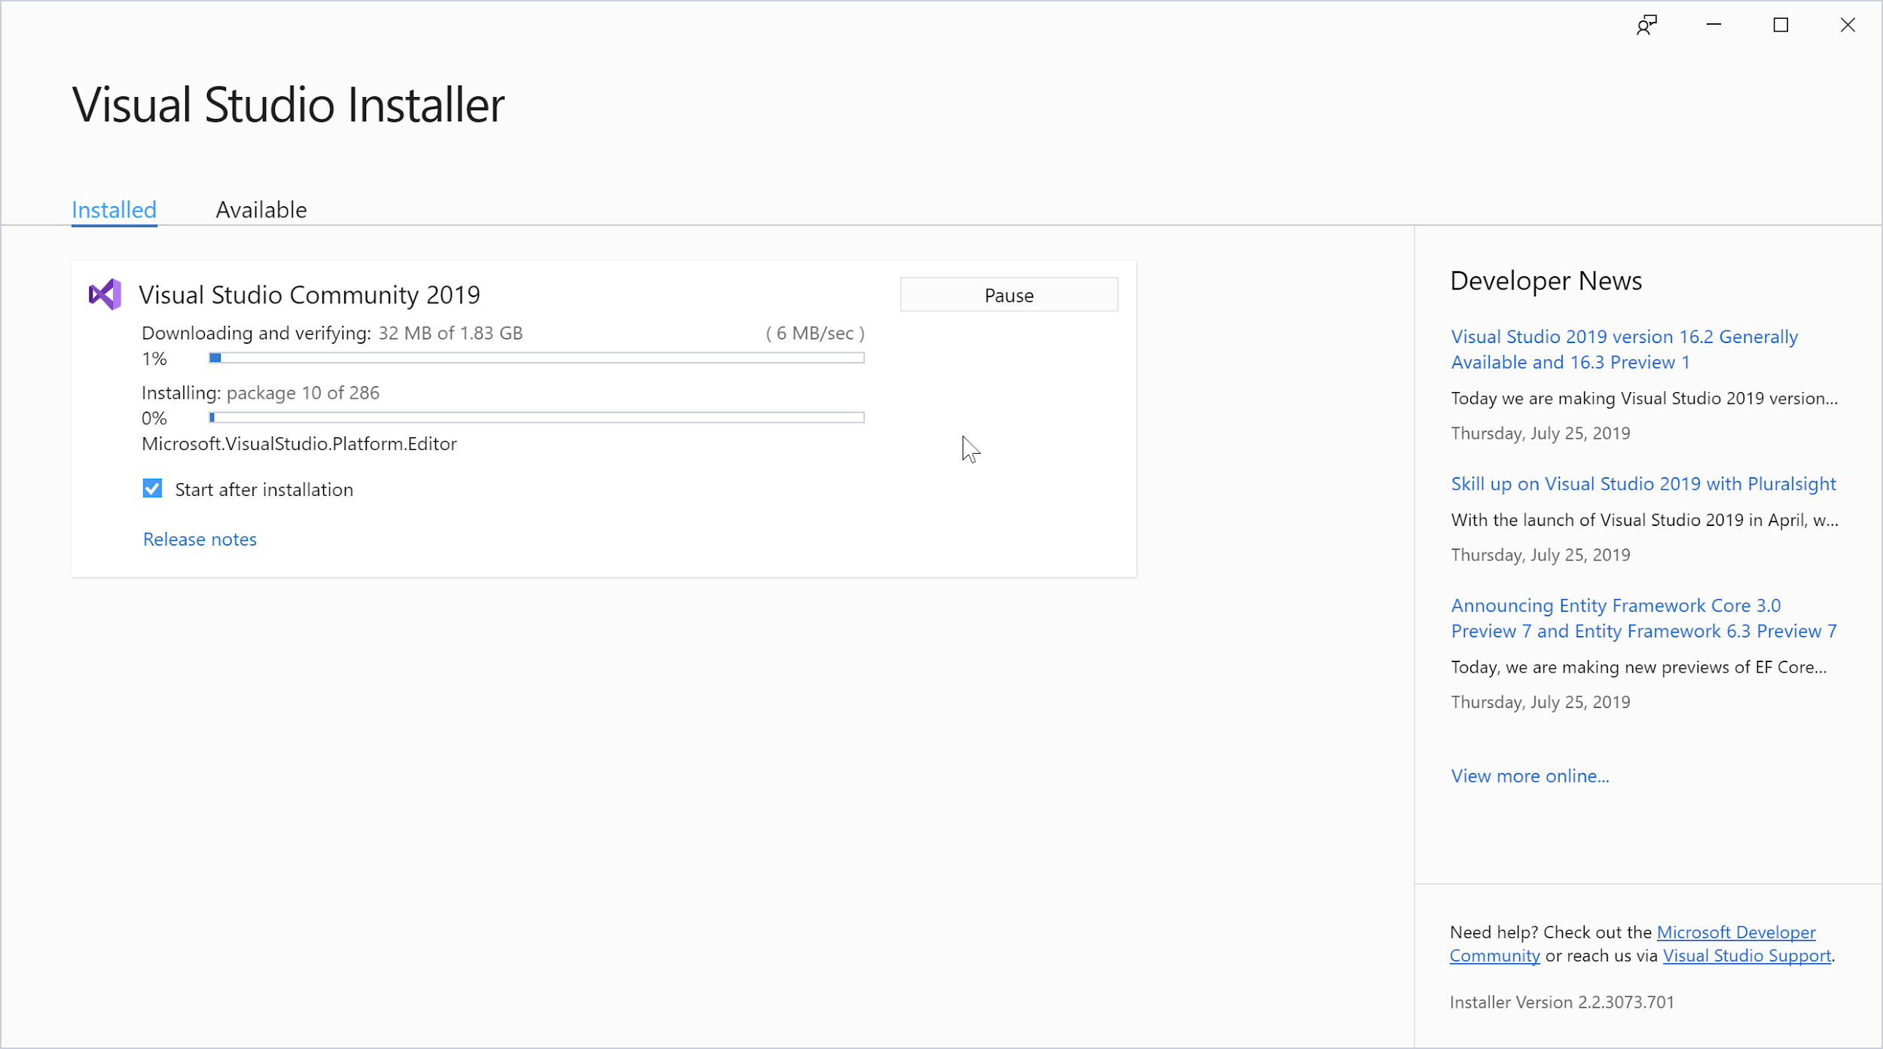

Slide 13
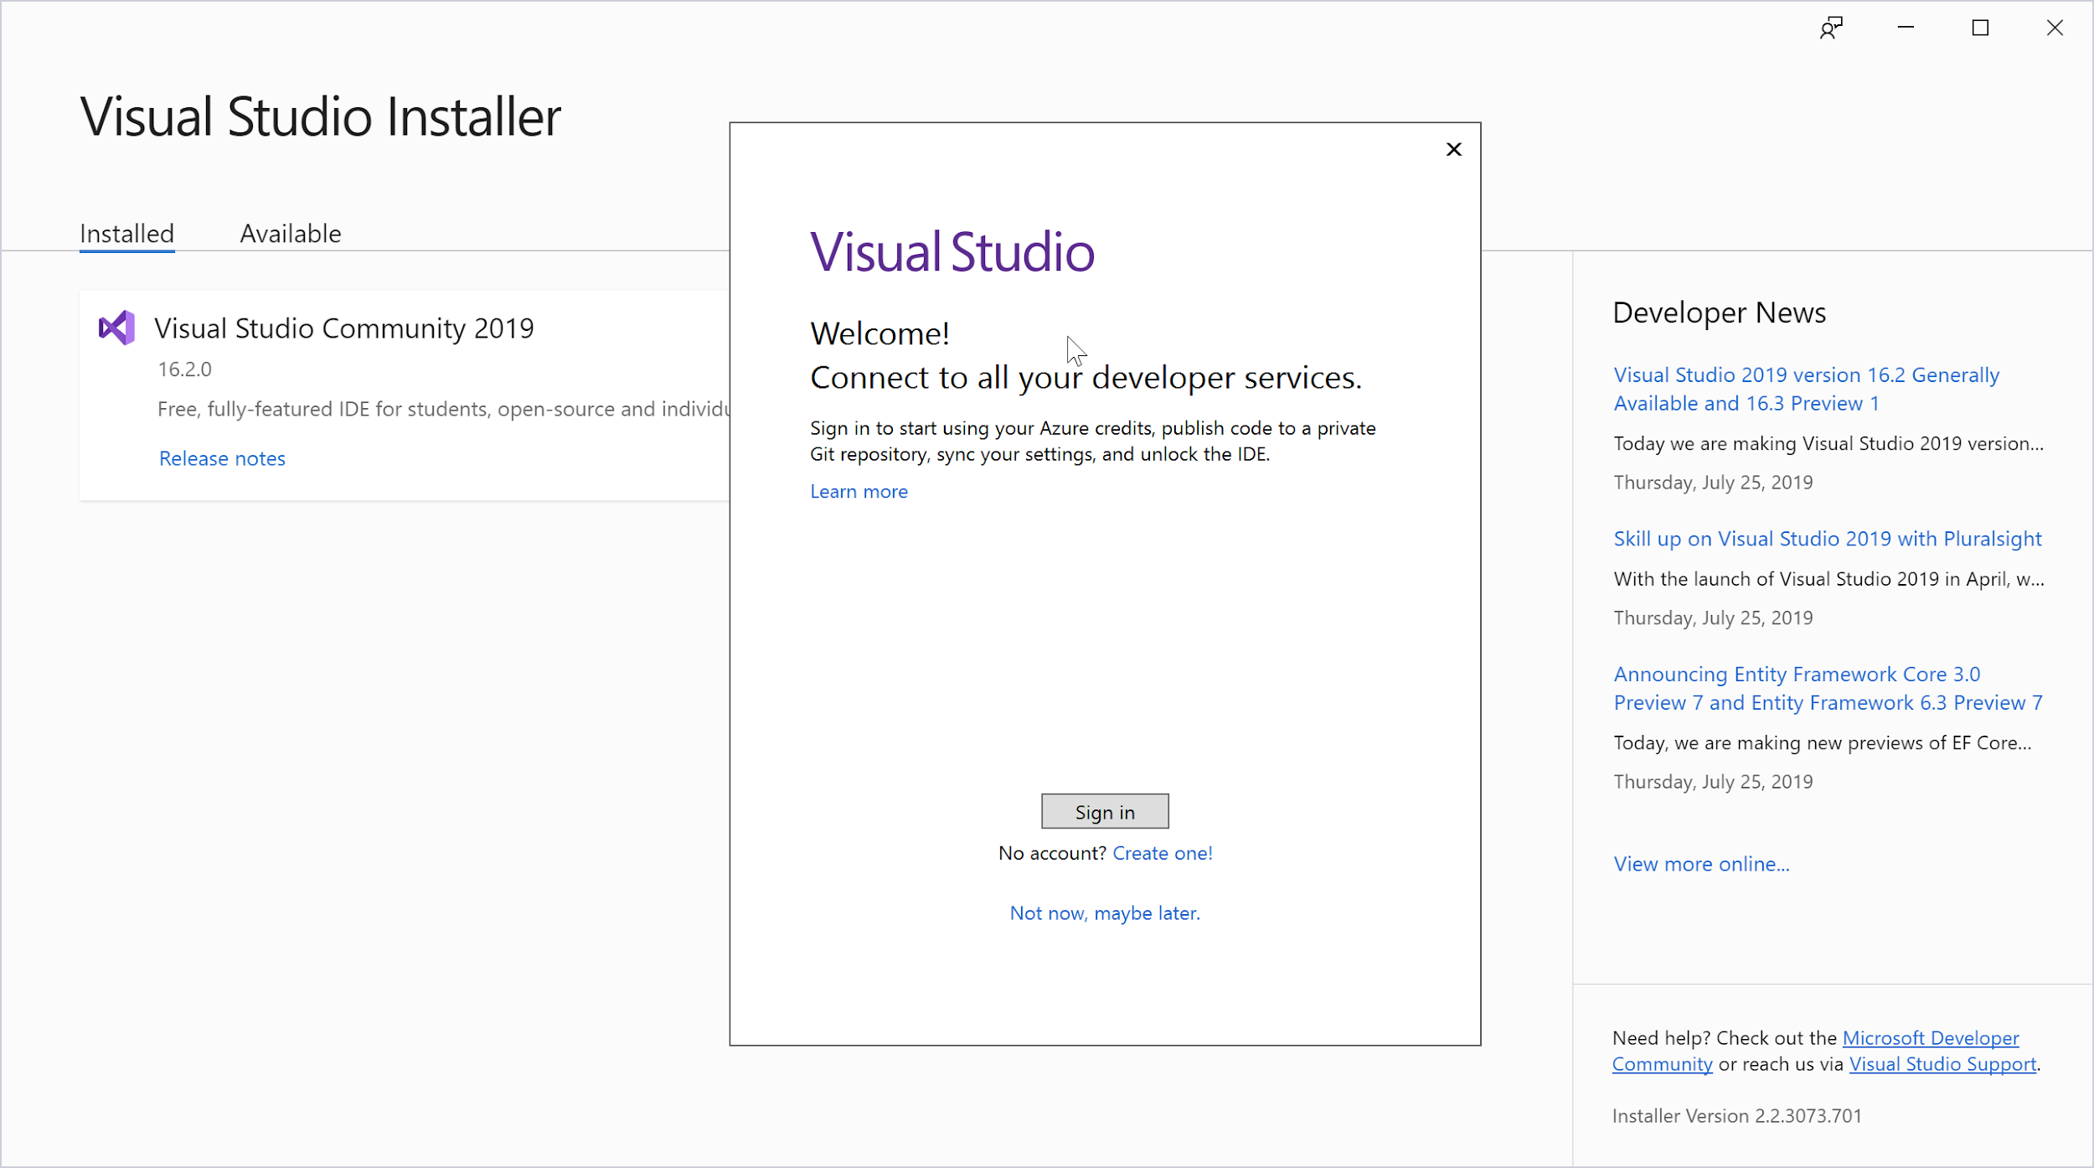

Slide 14
Install VS Community 2019
Get VS Community 2019 installed
Help each other in the community.

Slide 15
Install Prerequisites On MacOS

Slide 16
Unreal Development Environment

Slide 17
XCode & Epic Games Launcher
Get Xcode installing from the App Store
Agree to terms and conditions
If slow broadband let it finish, else continue
Also get Epic Games Launcher installing
Will use it soon to get Unreal downloading
Help each other in the community.

Slide 18
Build Unreal From Source (Linux)

Slide 19
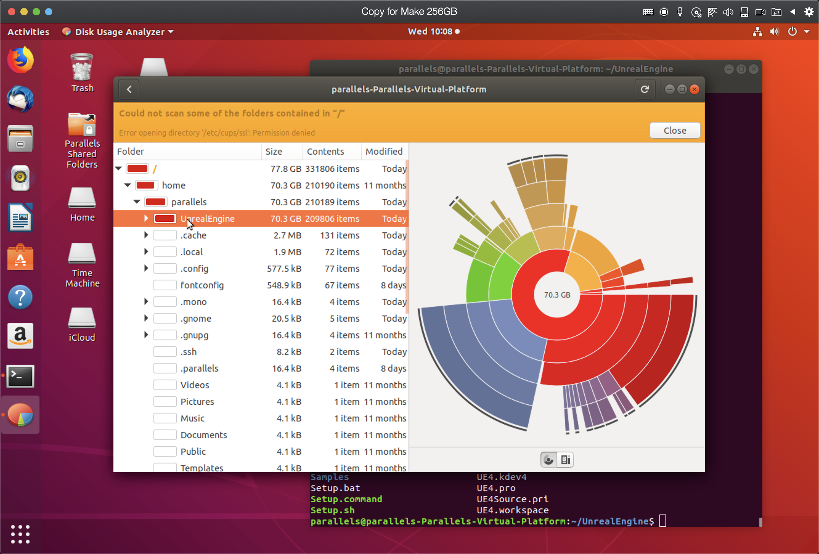
Have 70 GB+ Free

Slide 20
Build Unreal From Source
Download Unreal source from GitHub
Run ./Setup.sh
Run ./GenerateProjectFiles.sh
make UnrealEngine (will take hours)
Write-down start time
Share machine specs & build-time in forum.
sudo apt install g++ git make -y
git clone --single-branch --branch 4.22 https://github.com/EpicGames/UnrealEngine.git
Create GitHub "Personal Access Token" with "repo" access (or use SSH)
cd UnrealEngine
./Setup.sh (register Unreal file types when asked)
./GenerateProjectFiles.sh (much faster)
make will take some time (add -j x to set x jobs). Have 100GB+ free.
cd Engine/Binaries/Linux/ then run ./UE4Editor Celebrate!
Vulkan warning? Update or ./UE4Editor -opengl
Write-down start time & share build-time & specs with community!
Notes:
-j for jobs
Crazy but fun on Mac and Windows!

Slide 21
Install Unreal Engine 4.22 (Mac & PC)

Slide 22
Start Unreal 4.22 Downloading
Linux users can skip this video
Use the Epic Games Launcher
Download Unreal Engine 4.22.X (X doesn’t matter)
Carry-on with the course during download
Can resume following restart if required.
Notes:
Show progress bar format

Slide 23
Why Are YOU Taking This Course?
Share your hopes with your peers
Why did you buy the course?
What do you hope to build / learn / create?
This isn’t going to be easy
What’s going to keep you going?

Slide 24
Also Install Visual Studio Code

Slide 25
Why Also Install VS Code?
Fast, Free and Familiar
Supported in Unreal since 4.18
The same on Windows, MacOS & Linux
About 10x smaller to download
Please use the same drive as VS Community
Can extend to our needs later.
Notes:
VS Code like a buffet
https://www.unrealengine.com/en-US/blog/unreal-engine-4-18-released
https://blog.codinghorror.com/there-aint-no-such-thing-as-plain-text/
https://www.youtube.com/watch?v=UHS-aenkPPg

Slide 26
Install VS Code
Get VS Code installed
Add the Microsoft C/C++ extension
Watch-on for tips & testing.

Slide 27
VS Code Survival Tips
Preferences: Color Theme from cog or...
View > Command Palette to access anything
Tick File > AutoSave to save your sanity
Compiling code is separate to running it
VS Community or Xcode optional alternative.

Slide 28
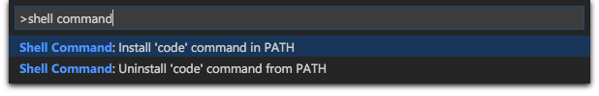
Extra VS Code Setup on MacOS
For compiler to work on MacOS you’ll need to
Launch VS Code from your terminal with code
Make that possible like this...

Slide 29
Section Wrap-up

